Slide 1
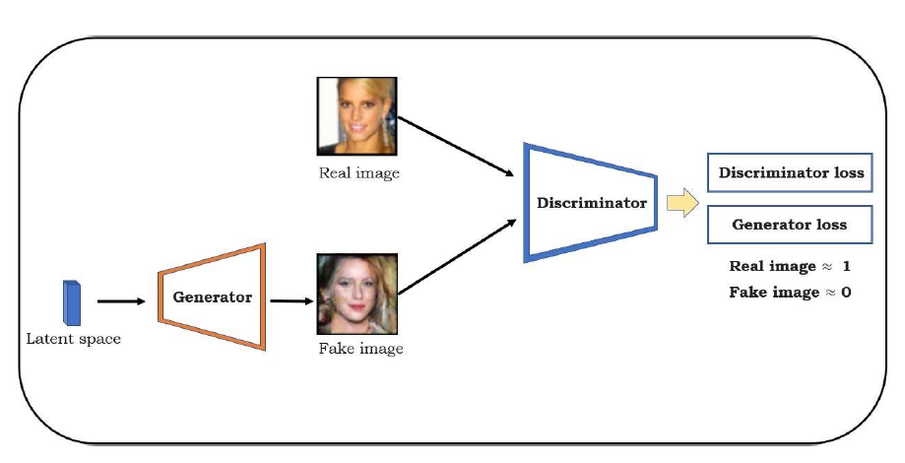
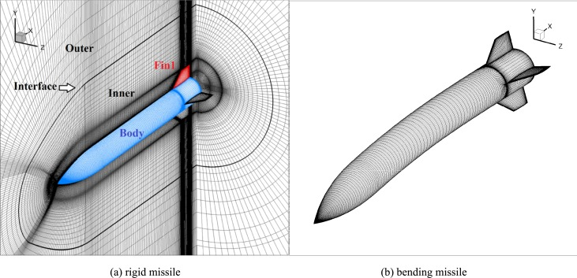

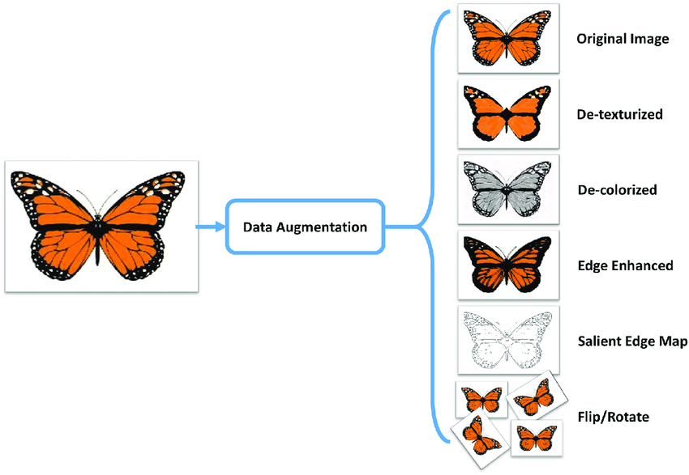
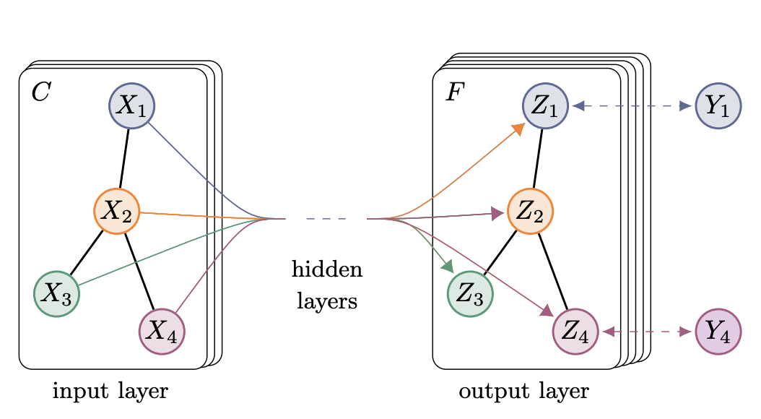
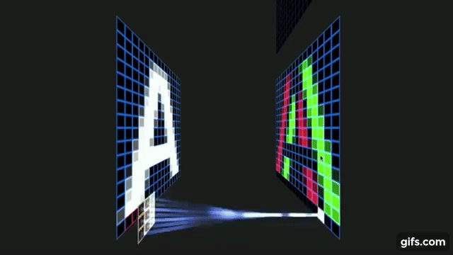

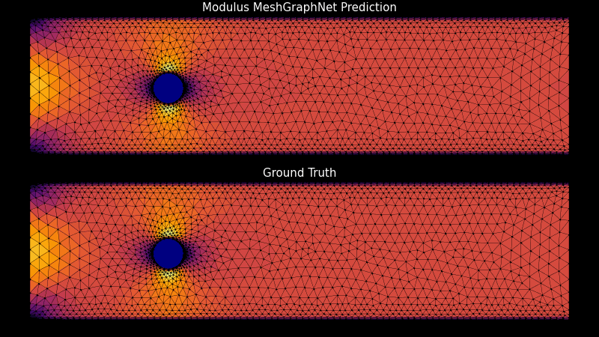
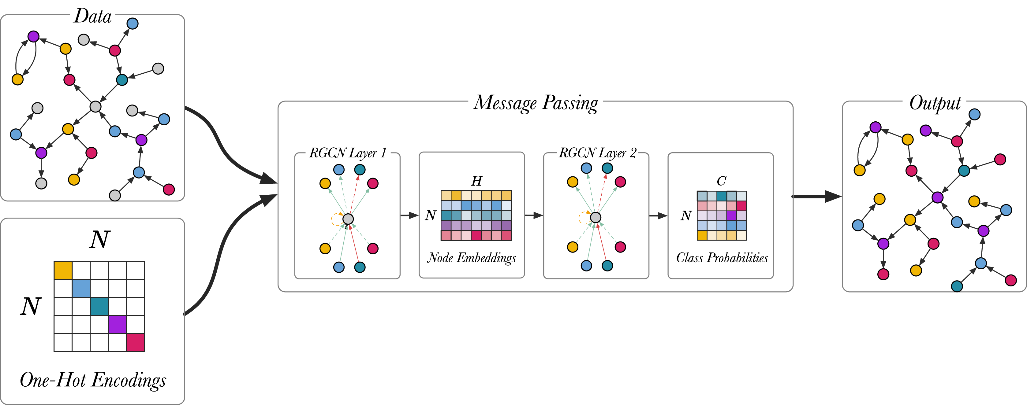
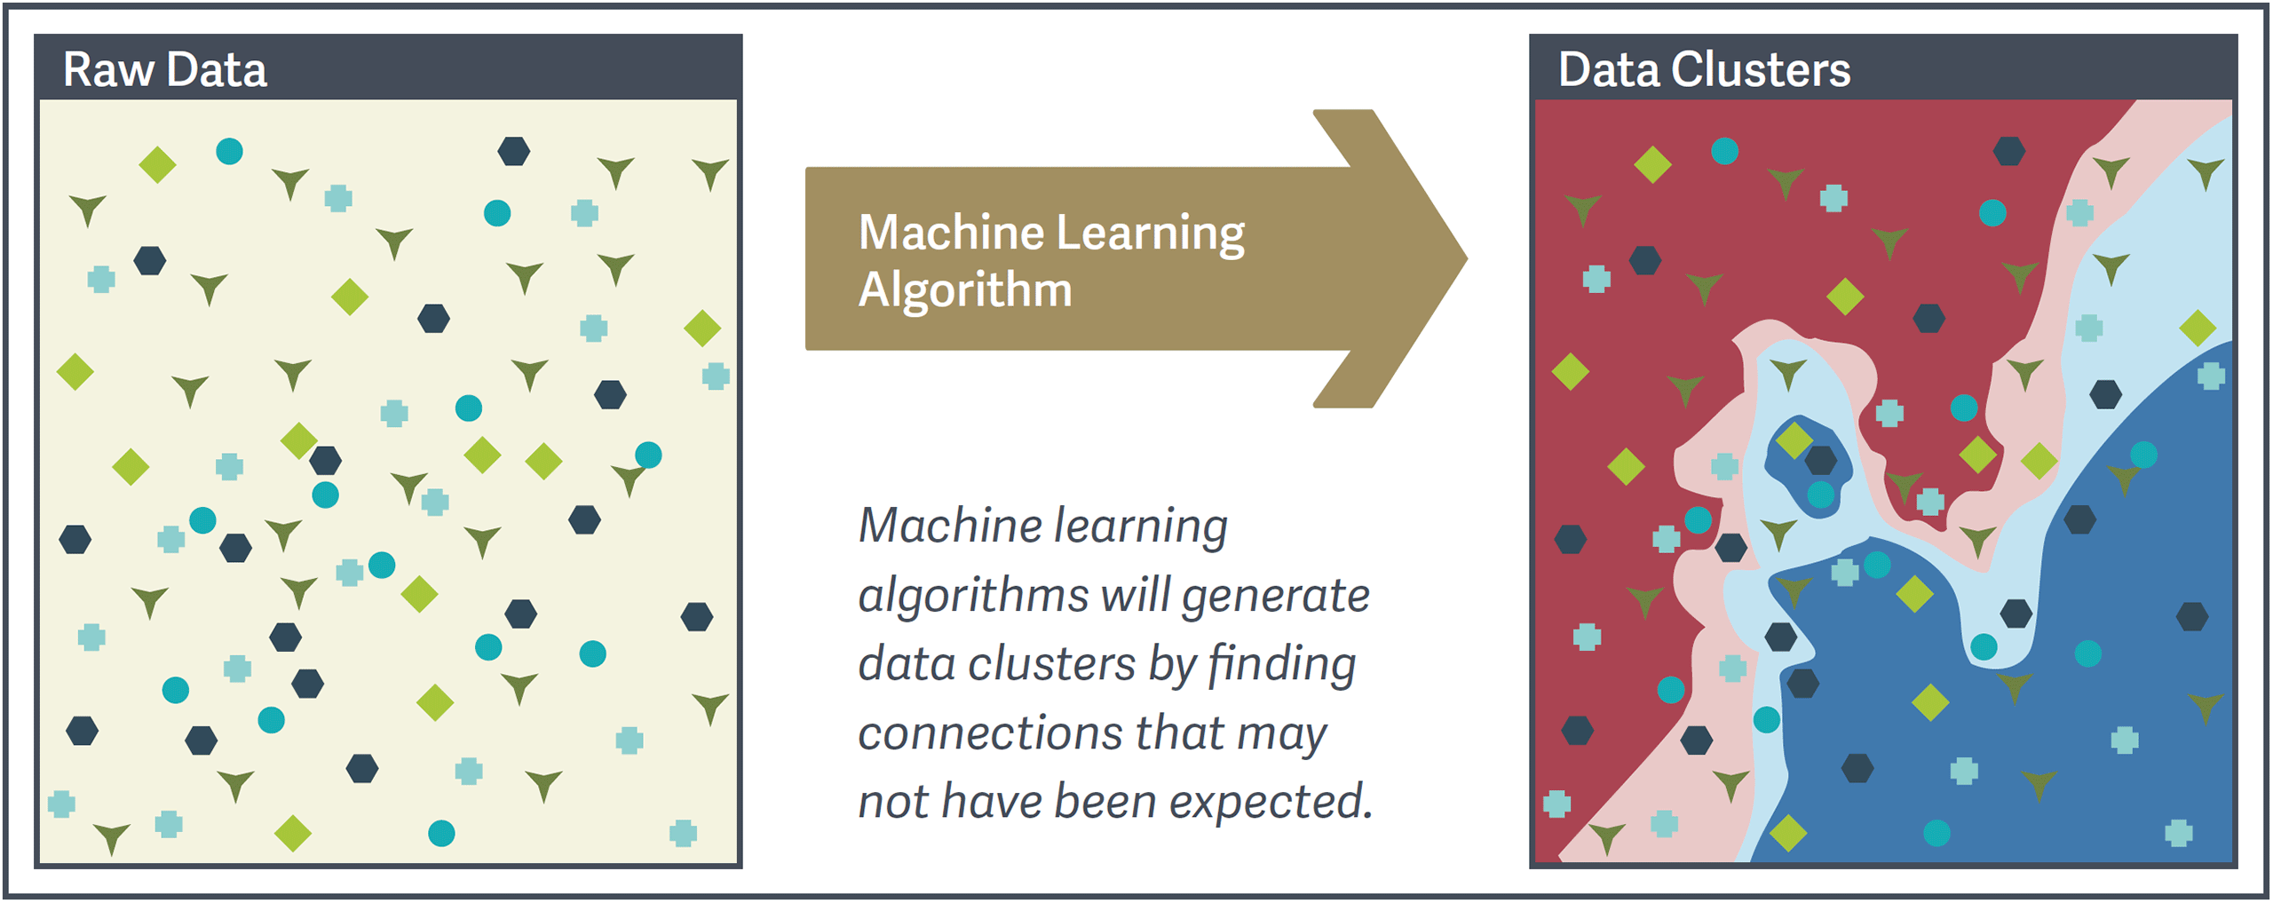

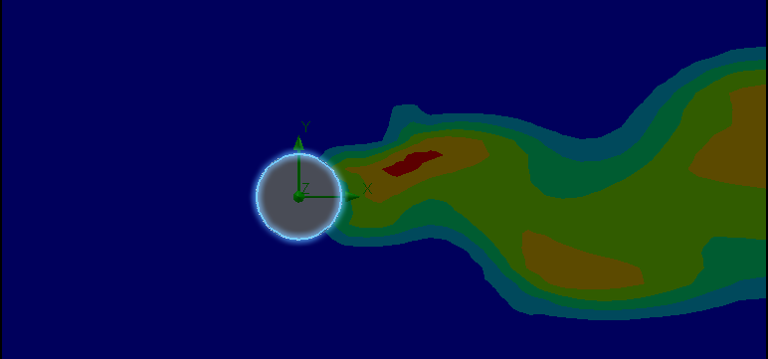
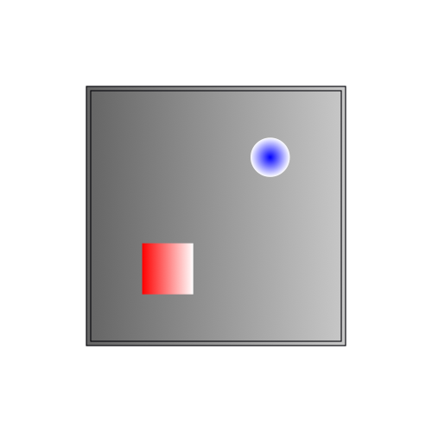
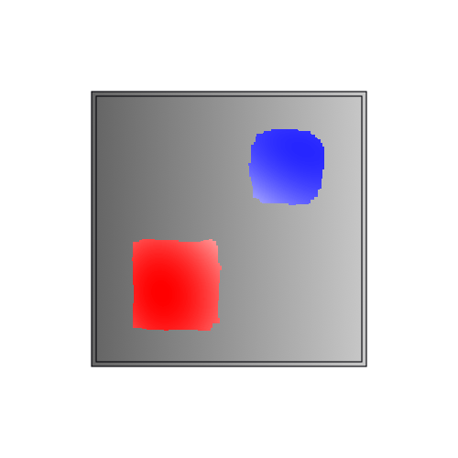

10x
Simulation speed and highest feasible yield, accuracy to the results or classifications

Slide 2
Mission
Challenges
Method
Goal
10x
Convolutional Neural Network (CNN)
Graphical Convolutional Neural Network (GCN)
Notes:
Here is what a Direct Feed Forward Neural Network(DFF), Convolutional Neural Neural Network (CNN), Graphical Convolutional Neural Network (GCN), and a Relational Graphical Convolutional Networks (RGCN)

